Slide 1

Algorithm Efficiency of an Algorithm; Basic complexity analysis – Best Worst and Average Cases
Data Structure | Introduction to Data Structure
Course: Data Structure | Chapter: Introduction to Data Structure | Program: Bachelor of Engineering
DISCOVER · LEARN · EMPOWER
Notes:
Welcome everyone to today's lecture on Algorithm Efficiency. We will focus on how to measure the performance of algorithms before we even write a single line of code. Understanding these concepts is crucial for selecting the right data structures for real-world engineering problems. Let us begin by exploring why efficiency matters in the context of our course outcomes.

Slide 2
Course Outcomes
SLIDE 2 / 10
Course Outcome
CO | BT LEVEL | DESCRIPTION
CO1 | BT1 | Understand and apply basic data structures, algorithms, complexity analysis, ADTs, arrays and linked lists.
CO2 | BT2 | Apply and implement stacks and queues in problem-solving.
CO3 | BT3 | Analyse and apply searching, sorting, and hashing techniques.
CO4 | BT4 | Construct and apply tree structures and traversal techniques.
CO5 | BT5 | Represent and solve graph problems using DFS, BFS, and graph algorithms.
Chandigarh University
2 / 10
Notes:
Today's lecture directly supports our Course Outcomes CO3 and CO4. By analyzing algorithm efficiency, you will learn to select the best searching or sorting technique for a specific problem. This analysis also guides you in constructing efficient tree structures and traversal methods. Without understanding complexity, you cannot effectively apply these techniques in engineering scenarios.

Slide 3
Learning Objectives
SLIDE 3 / 10
Learning Outcomes
1
Define algorithm efficiency and its importance in data structure design.
2
Analyze the three cases: best, worst, and average for any algorithm.
3
Differentiate between time complexity and space complexity metrics.
4
Apply Big O notation to quantify algorithm performance growth rates.
5
Evaluate practical examples to determine the most efficient approach.
Chandigarh University
3 / 10
Notes:
By the end of this session, you will be able to define what makes an algorithm efficient. You will learn to distinguish between best, worst, and average cases using concrete examples. We will also practice applying Big O notation to quantify how performance scales. Finally, you will be able to evaluate different approaches to choose the most efficient one.

Slide 4
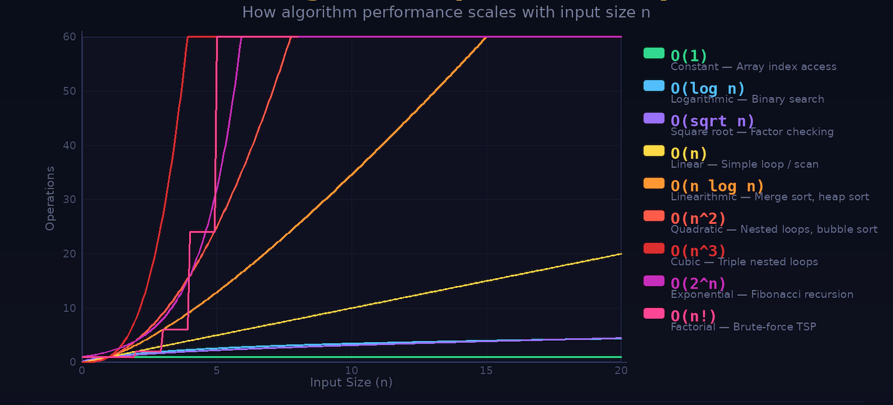
Lecture
SLIDE 4 / 10
Defining Algorithm Efficiency
1
Algorithm efficiency measures the resources required to execute a program.
2
Primary resources include execution time and memory space consumption.
3
Efficiency is independent of hardware speed or programming language used.
4
It focuses on how resource usage grows as input size increases.
5
We use asymptotic analysis to compare algorithms theoretically.
Big-O Notation Explained Clearly (Time & Space Complexity Guide for Beginners) - Blog- CodeKerdos
Chandigarh University
4 / 10
Notes:
Algorithm efficiency is not about how fast your computer is, but how the algorithm behaves as data grows. It measures the resources, specifically time and space, required to execute a program. We focus on the growth rate of these resources rather than absolute execution time. This theoretical approach ensures our solutions remain efficient regardless of the hardware used.

Slide 5

Lecture
SLIDE 5 / 10
Best Case Analysis
EXAMPLE
Linear search finds the target at the very first position.
• Best case represents the minimum time required for any input.
• It occurs when the algorithm encounters the most favorable input data.
• Best case complexity is often denoted as ω (Ω) notation.
• It provides a lower bound on the algorithm's performance.
Source: miro.medium.com
Chandigarh University
5 / 10
Notes:
The best case scenario is the absolute fastest an algorithm can run. For a linear search, this happens if the target element is found at the very first index. This gives us the minimum time required, often represented by ω notation. However, relying solely on the best case can be misleading for real-world performance guarantees.

Slide 6
Lecture
SLIDE 6 / 10
Worst Case Analysis
EXAMPLE
Linear search finds the target at the last position or not at all.
• Worst case represents the maximum time required for any input.
• It occurs when the algorithm encounters the most unfavorable input data.
• Worst case complexity is denoted as Big O (O) notation.
• It guarantees an upper bound on the algorithm's execution time.
Chandigarh University
6 / 10
Notes:
The worst case scenario is the absolute slowest an algorithm can run. In a linear search, this happens if the target is at the very end or missing entirely. This gives us the maximum time required, represented by Big O notation. Engineers rely on this to guarantee that a system will never exceed a certain response time.

Slide 7
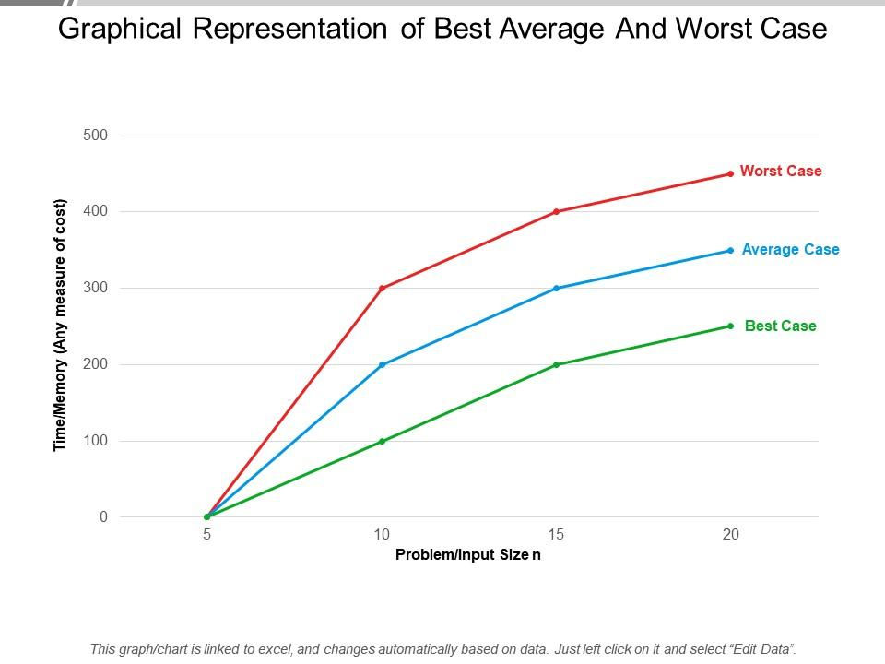
Lecture
SLIDE 7 / 10
Average Case Analysis
EXAMPLE
Linear search finds the target at the middle position on average.
• Average case represents the expected time for random inputs.
• It assumes a uniform probability distribution for all possible inputs.
• Average case complexity is often denoted as θ (Θ) notation.
• It provides a realistic estimate of typical algorithm performance.
Source: www.slideteam.net
Chandigarh University
7 / 10
Notes:
The average case gives us the expected performance over many random inputs. For a linear search, we assume the target is equally likely to be anywhere in the list. On average, we will find it in the middle, requiring half the comparisons. This provides a realistic estimate of how the algorithm behaves in typical usage scenarios.

Slide 8
Lecture
SLIDE 8 / 10
Worked Numerical Example
GOVERNING EQUATION
Consider Linear Search on an array of size n = 100
BEST CASE
Target at index 0 requires 1 comparison (O(1)).
WORST CASE
Target at index 99 requires 100 comparisons (O(n)).
AVERAGE CASE
Target at index 50 requires 50 comparisons (O(n)).
FORMULA
Average comparisons = (n + 1) / 2 for successful search.
Source: www.slideteam.net
Chandigarh University
8 / 10
Notes:
Let's look at a concrete example with an array of 100 elements. In the best case, we find the item immediately, taking just 1 comparison. In the worst case, we check every single element, taking 100 comparisons. On average, we expect to check half the elements, which is 50 comparisons. This clearly shows how the input distribution drastically changes performance.

Slide 9
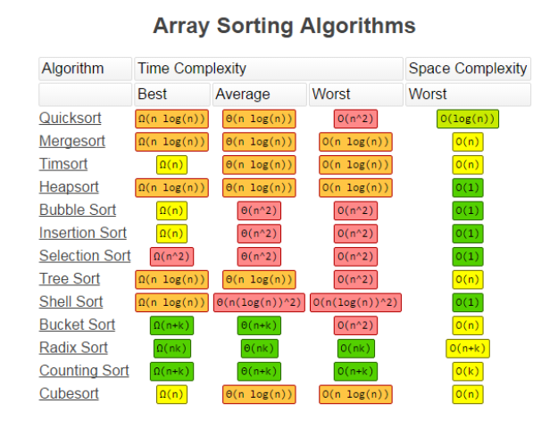
Lecture
SLIDE 9 / 10
Key Takeaways
1
Algorithm efficiency measures resource usage relative to input size growth.
2
Best case gives the minimum time (ω), worst case gives maximum (Big O).
3
Average case provides the expected performance for random inputs.
4
Big O notation is the standard for describing upper bounds of complexity.
5
Understanding these cases is essential for selecting optimal data structures.
Source: blogger.googleusercontent.com
Chandigarh University
9 / 10
Notes:
To summarize, algorithm efficiency is about how resources grow with input size, not absolute speed. We must analyze best, worst, and average cases to fully understand an algorithm's behavior. Big O notation remains the standard for describing the upper bound of this growth. Mastering these concepts is essential for your future work in data structures and engineering.

Slide 10
Lecture
SLIDE 10 / 10
References
DATA STRUCTURES
A Pseudocode Approach with C — Gilberg, Forouzan
• Data Structures — Lipschutz
• Data Structure Using C — AK Sharma
• C and Data structure — P. S. Deshpandey
Chandigarh University
10 / 10
Notes:
For further reading, please refer to the standard textbooks listed on this slide. These resources provide detailed pseudocode and C implementations for the algorithms we discussed. They also cover the mathematical foundations of complexity analysis in greater depth. I encourage you to review these texts to solidify your understanding of the material.

